Slide 1

HOTEL BOOKING DEMAND
-by
SARVANI ATCHUTUNI

Slide 2
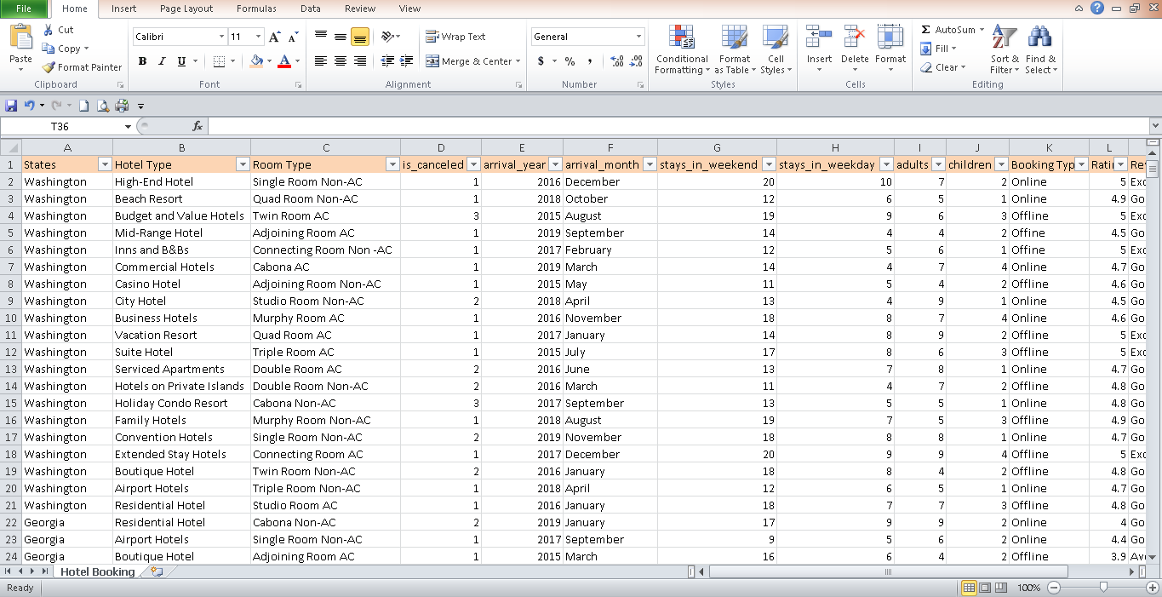
DATASET
I have taken this dataset from Kaggle.
I have taken the Dataset that consists of 500 rows and 15 columns.

Slide 3
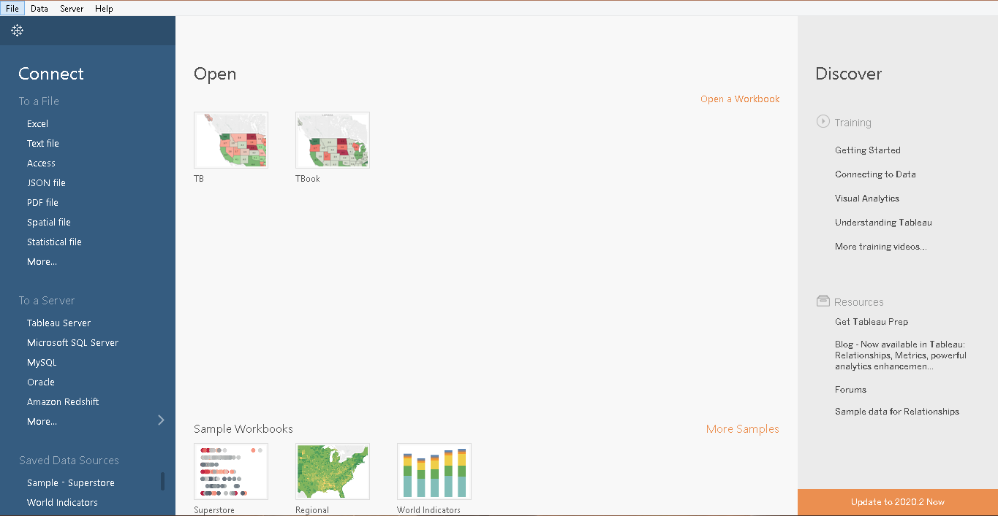
We have to save this dataset and then Open TABLEAU . Here i have imported the data from Excel.

Slide 4
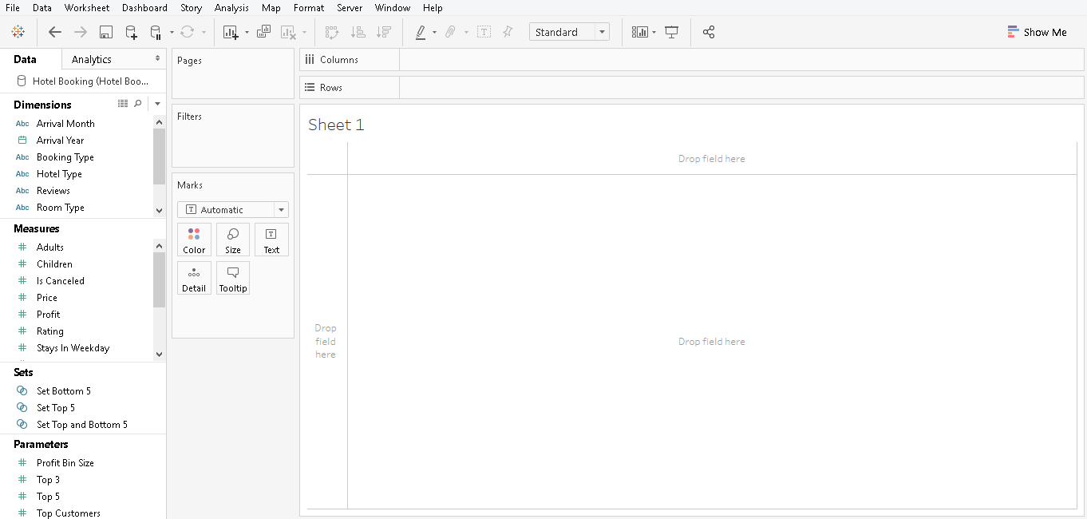

Slide 5
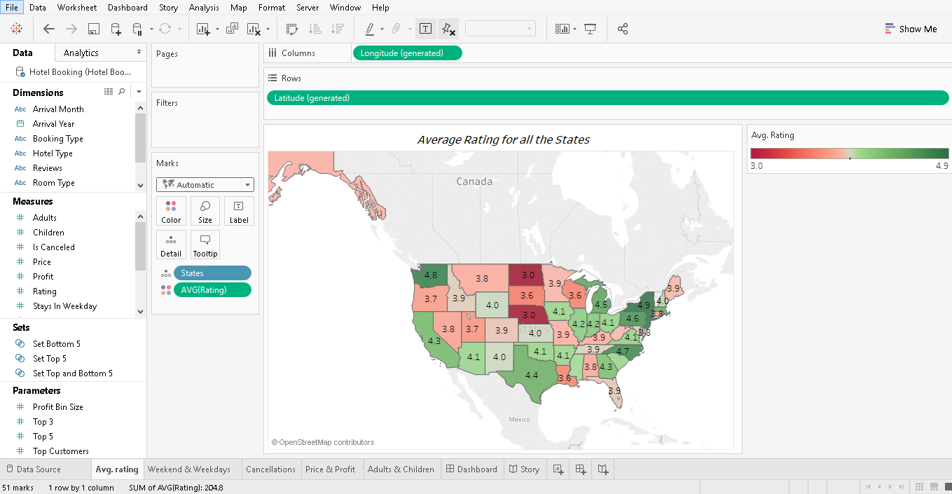
In this Filled map, I have taken the overall rating for hotel booking in all the states in USA.
It is clear that New york has the highest overall rating among all the states.

Slide 6
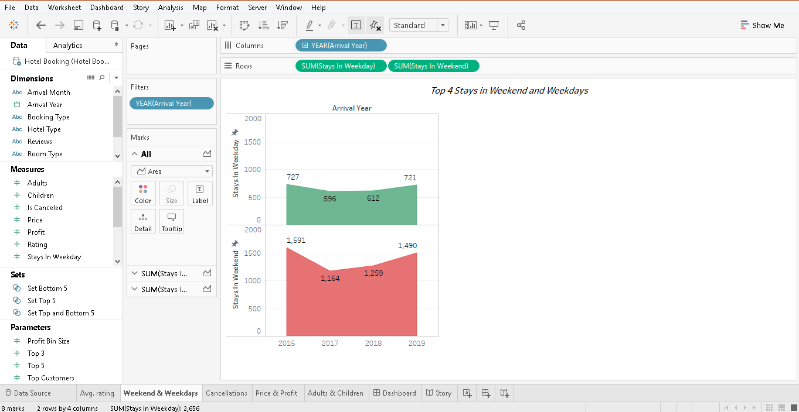
In this Area chart, I have compared the number of people booking hotels in weekends and weekdays.
From the chart, it is clear that the bookings are quite high in weekends than in weekdays in all the years.

Slide 7
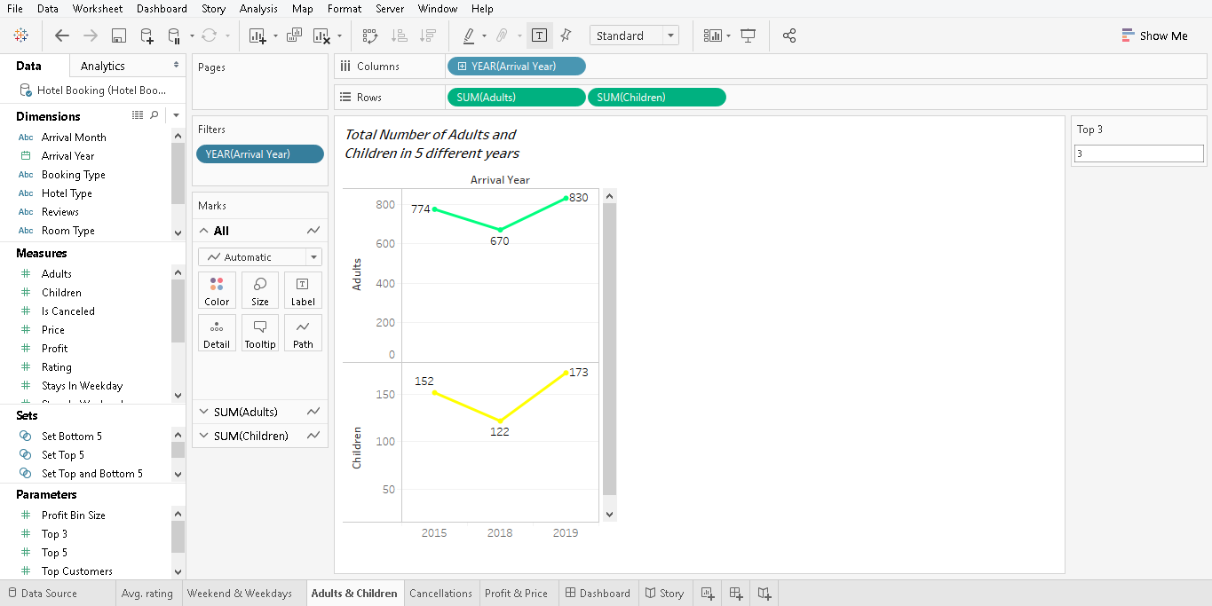
In this Line chart, I have represented the number of adults and children visiting the hotel.
It is clear that there are more number of adults compared to children.

Slide 8
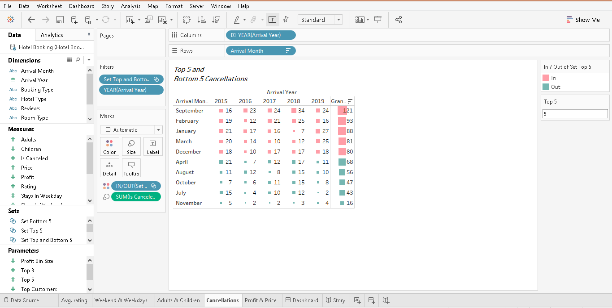
In this Heat map, I have represented Top 5 and Bottom 5 cancellations of hotel bookings in all the months in 5 different years.
It is clear that January has the higher number of cancellations whereas November has less cancellations.

Slide 9
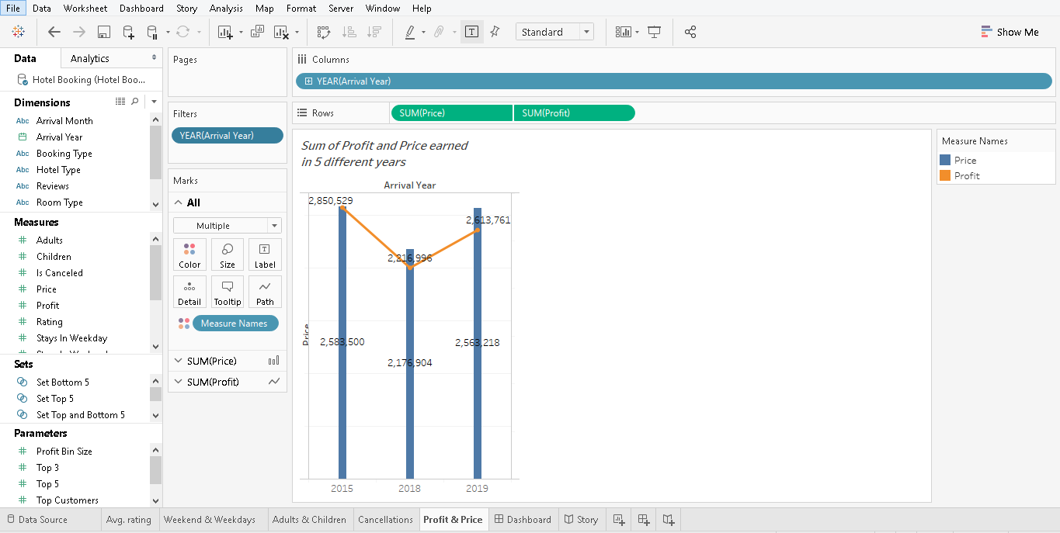
In this Dual line chart, I have taken the profit and sales so that together they will give a clear picture.

Slide 10
PROBLEM STATEMENTS
From the filled map, the statement is that it is not recommended to book the hotels in North Dakota and Nebraska because it has very less overall rating .
From the area chart, the implication is that it is better to book the hotels in the weekends as the population is more in the weekends and there will be certain offers.
From the line chart, the inference is that it is mostly recommended for the adults to visit the hotel compared to children.
From the heat maps, the inference is that it is not recommended to book the hotels in the month of September and February because there are more number of cancellations taking place.
From the dual line map, the implication is that the hotels are earing quite higher profit .

Slide 11
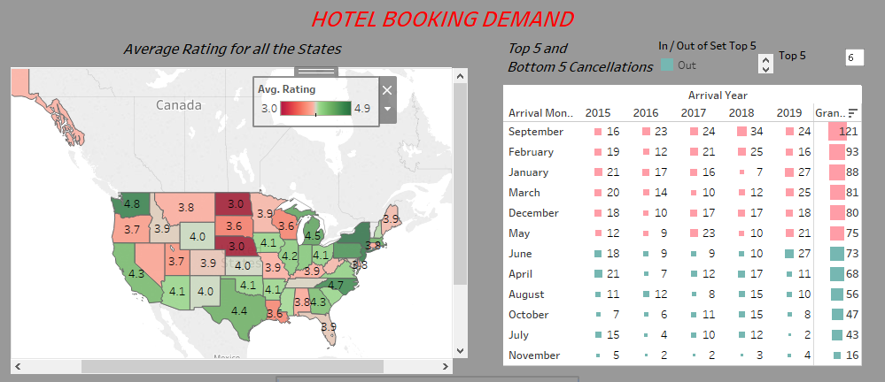
DASHBOARD

Slide 12
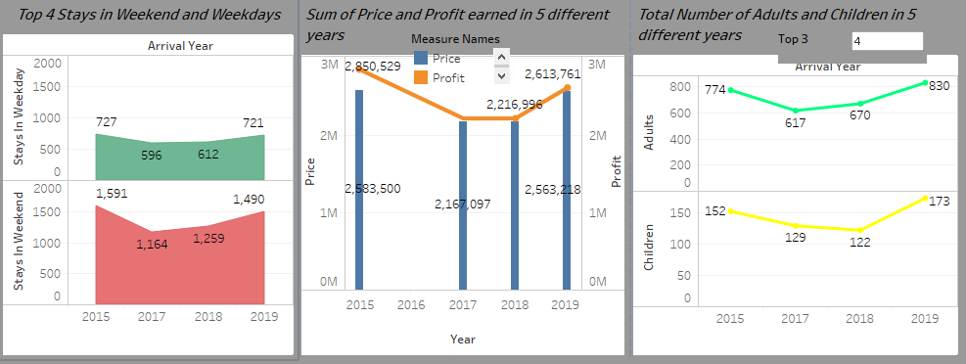

Slide 13
SUMMARY
In the filled map, the overall rating for hotel booking is taken. From that New york has the highest overall rating with 4.9 and the second is Washington with 4.8 rating. North Dakota and Nebraska has the lowest overall rating.
From the Area chart, it is understood that number of booking are higher in weekends compared to weekdays in all years. Here i have used Bottom filter to filter out the bottom 4 years for population in weekends and weekdays.
From the line chart, it is clear that the in all the 5 years the more number of visitors are adults when compared to children. Here I have used parameter and also Top filter to represent top 3 years for sum of adults and children.
From the heat maps, it is clear that September month has more number of cancellations as it is not a good vacation time whereas November has less cancellations as it is a good season for vacation. Here I have used parameter and also set to represent Both Top 5 and Bottom 5 cancellations in one chart.
From the dual line map, it is clear that they are earning extra amount other than the price for extra activities like games, swimming etc. Here I have used Top filter to represent the top 3 years in which the Profit and Price are higher.

Slide 14
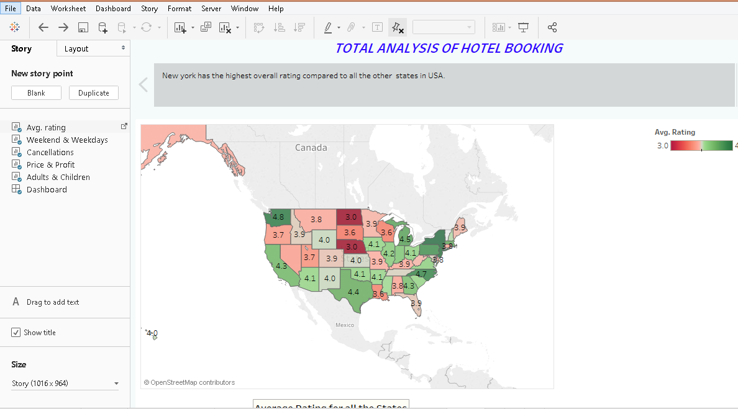
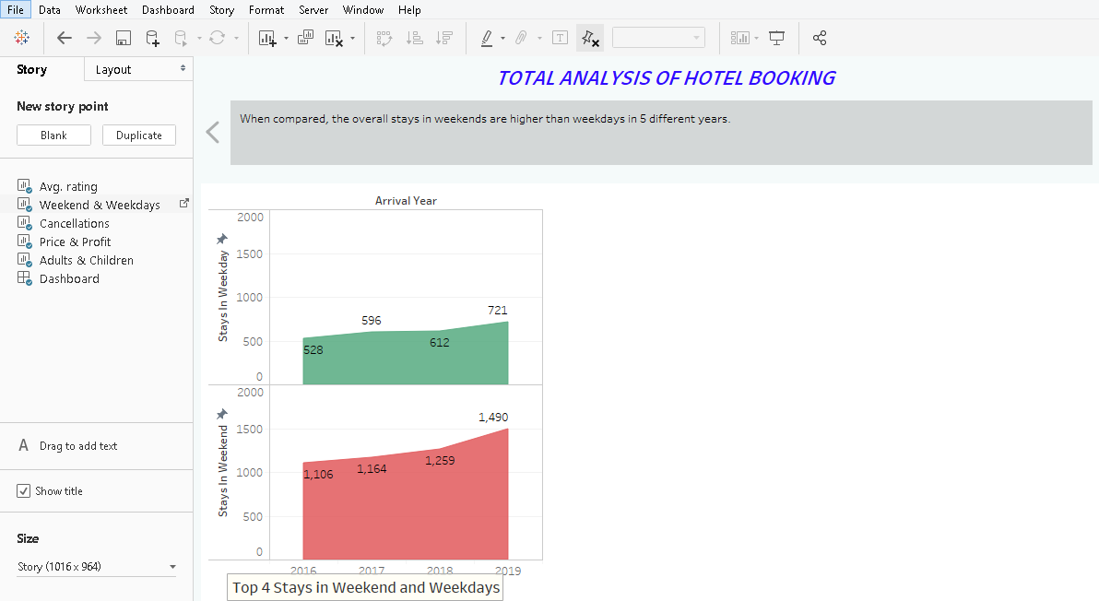
STORY

Slide 15
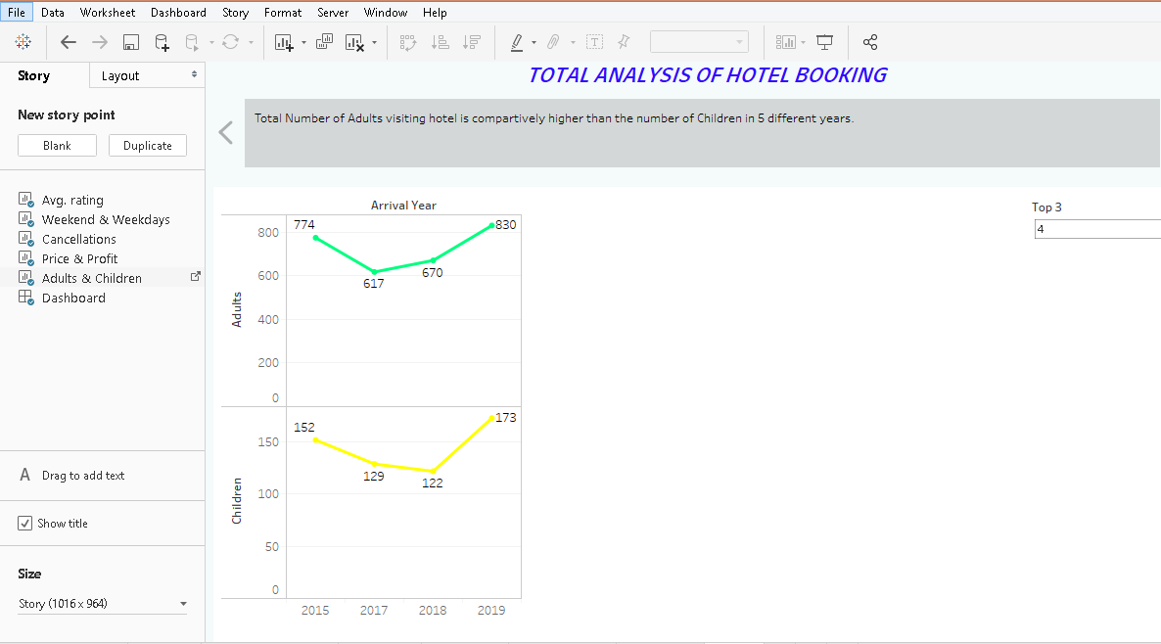
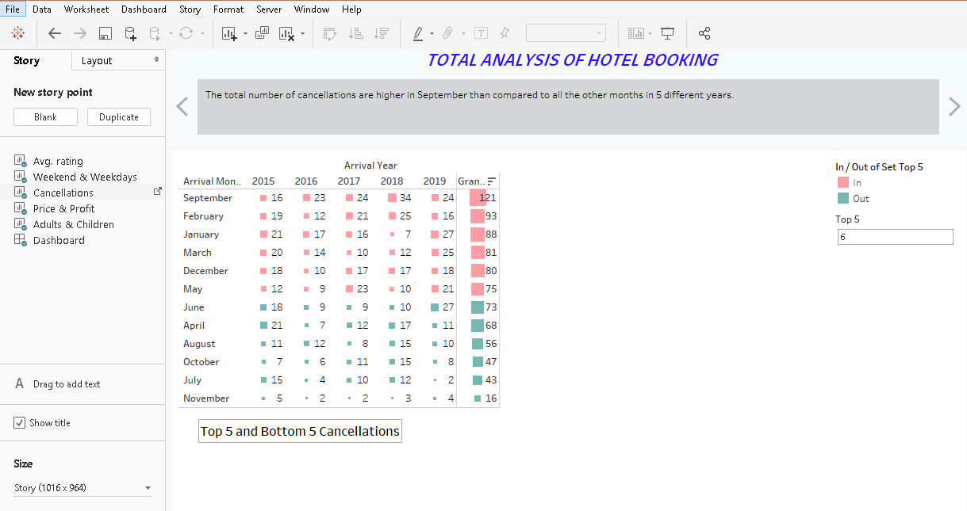

Slide 16
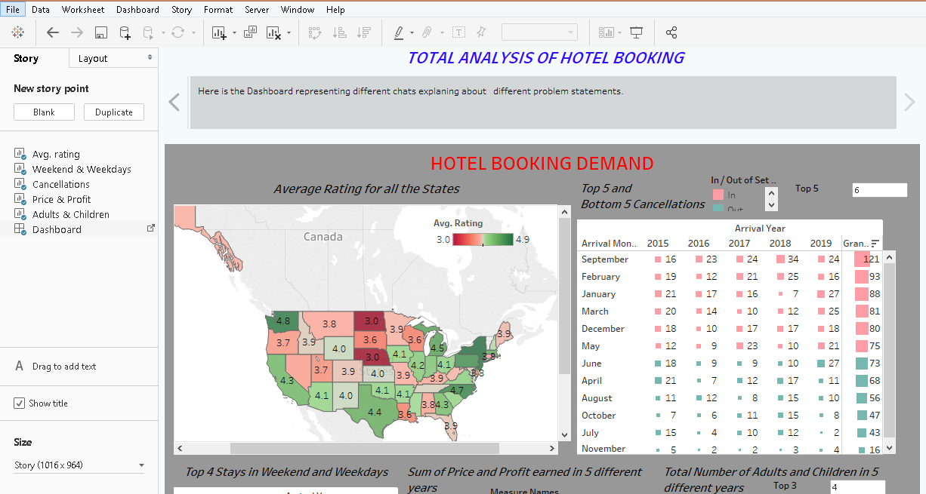
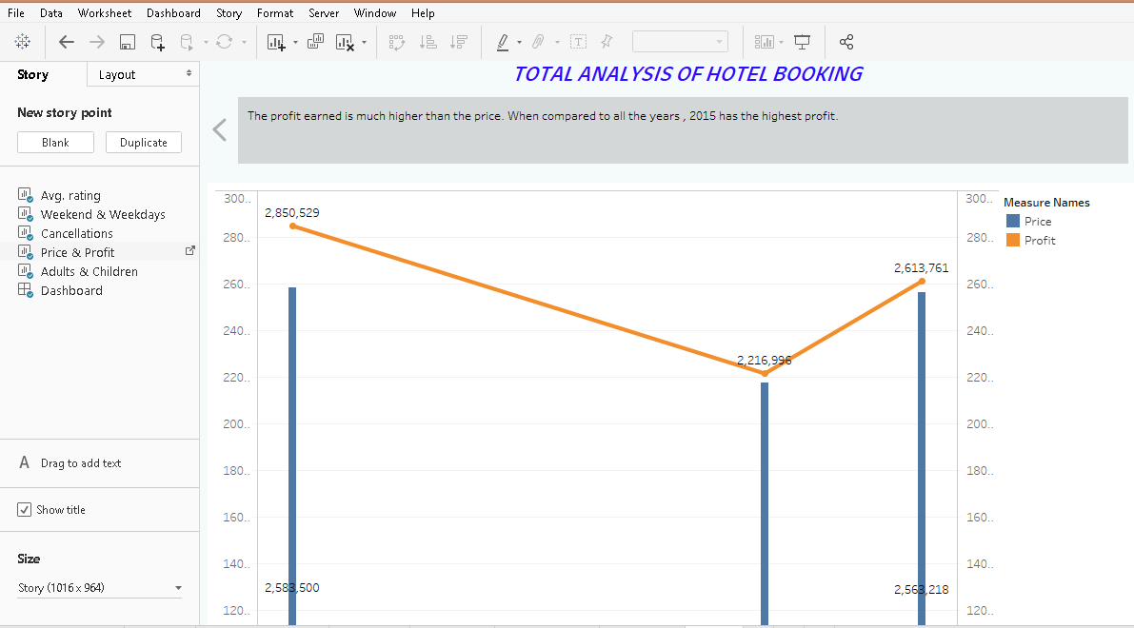

Slide 17
VIDEO LINK
https://drive.google.com/open?id=1NUbbUMYhrmD0GnG8Emy8cyypOHwshPkG

Slide 18
CONCLUSION
It is better to book a hotel by looking at the rating as it is very important and also at the price because many top rated hotels come with cheaper price . They are luxurious and are at affordable prices.
And the next main criteria is to book the hotel in the weekends and in months of November and July as they are good for vacations and complete family can enjoy.

Slide 19
Thank you ……

